Slide 1

Global Income Inequality Analysis
By-Shruti Awarkar

Slide 2
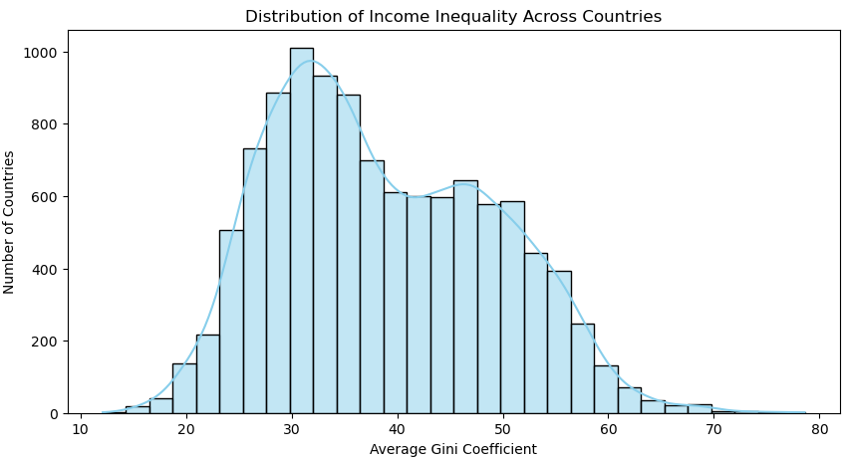
Distribution of Income Inequality Across Countries
Key Insight : Distribution of Income Inequality Across Countries
1.The highest concentration of countries lies around 30–35 Gini, indicating that most countries have moderate levels of income inequality.
2.There is another noticeable concentration in the 40–50 Gini range, showing that a significant number of countries experience high inequality levels.
3.The distribution also has a long right tail extending up to 70–80 Gini, which indicates that very high inequality exists but is limited to a few countries.
4. The lowest section of the chart (the far left, between 15 and 25 Gini)

Slide 3
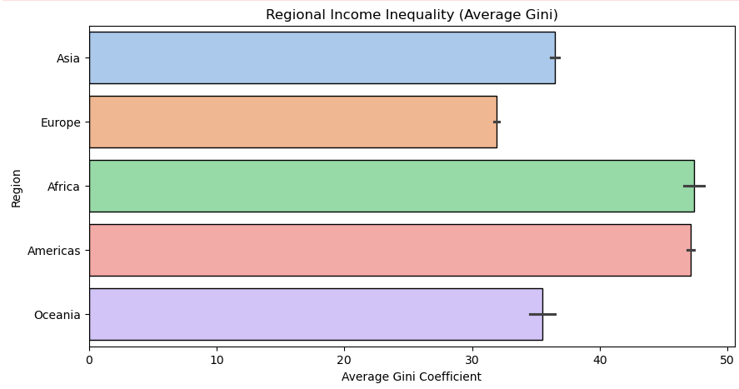
Regional Income Inequality (Average Gini )
Key Insight : Regional Income Inequality (Average Gini )
1.The Inequality Leaders: Africa and the Americas
Highest Levels: Africa (~47.5) and the Americas (~47.0) are the most unequal regions in the world.
2.The Middle Ground: Asia and Oceania
Moderate Inequality: Asia (~36.5)
and Oceania (~35.5) sit in the middle of the spectrum.
3.The Global Floor: Europe
Lowest Levels: Europe has the lowest
average Gini coefficient (~32.0).

Slide 4
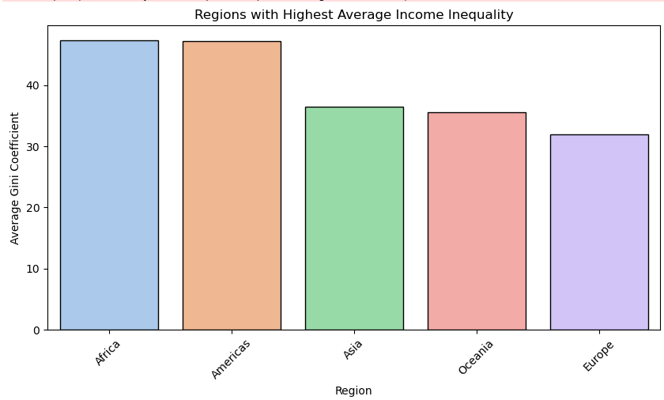
Regions with Highest Average Income Inequality
Key Insight : Regions with Highest Average Income Inequality
1.The High Inequality Tier: Africa & the Americas
The Leaders: Africa and the Americas are virtually tied at the top, both hovering near an average Gini of 47.
2.The Moderate Tier: Asia & Oceania
The Middle Ground: Asia (~37) and Oceania (~35) occupy the middle of the ranking.
3.The Benchmark Region: Europe
The Lowest: Europe stands out with the lowest average Gini coefficient (~32).

Slide 5
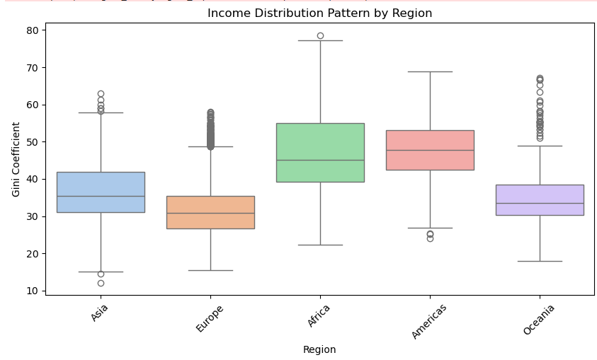
Income Distribution Pattern by Region
Key Insight : Income Distribution Pattern by Region
1.Europe: The Gold Standard of Consistency
Europe has the lowest median (~31) and the narrowest box (Interquartile Range).
2.The Americas: A High Inequality Floor
While Africa has a higher outlier, the entire box for the Americas is shifted higher up the scale (median ~48).
3.Africa: The Widest Internal Divide
Africa has the largest box and the longest whiskers, with values stretching from ~22 to nearly 80.
4.Asia & Oceania: Moderate but Spiky
Both regions have relatively low medians (~33–35), but they are characterized by extreme high outliers.

Slide 6
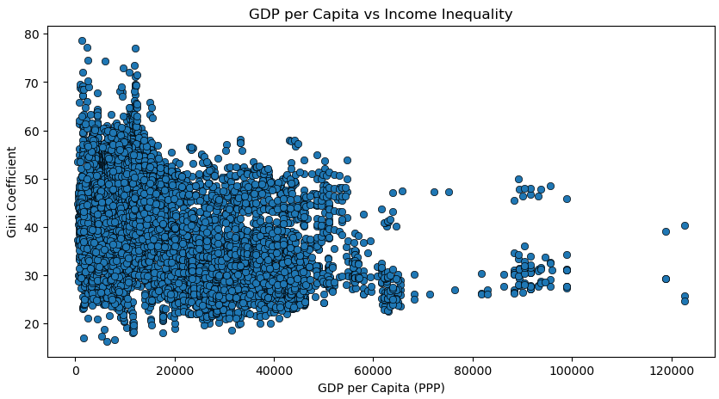
GDP per Capita vs Income Inequality
Key Insight : GDP per Capita vs Income Inequality
1. The Wealthy Stability Zone (High GDP)
1.As GDP per capita increases (moving right on the x-axis, beyond $60,000), the variation in inequality narrows significantly.
2.Almost all high-income nations cluster between a Gini of 25 and 45. You will notice there are zero countries with a GDP over $60,000 that have a Gini coefficient above 50.
2.The Volatility Zone (Low GDP)
1. At lower income levels (under $20,000), the data points are scattered across the entire vertical axis (from 15 to 80).
2.Some low-GDP nations are among the most equal in the world, while others are the most unequal.

Slide 7
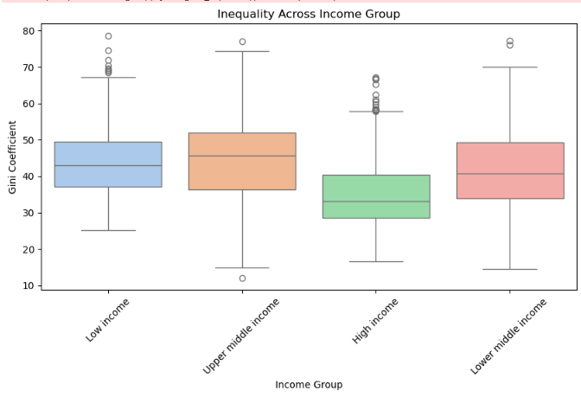
Inequality Across Income Group
Key Insight : Inequality Across Income Group
1.Upper Middle Income
The Upper Middle Income group has the highest median Gini coefficient (around 46).
2.High Income
The High Income group has the lowest median (around 33) and the most compact box (the smallest Interquartile Range).
3.Low Income and Lower Middle Income
Moderate-High inequality (~43).
The Low and Lower Middle Income groups contain the most extreme cases, with outliers reaching Gini scores near 80.

Slide 8
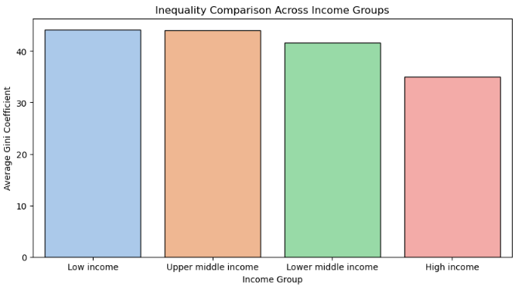
Inequality Comparison Across Income Groups
Key Insight : Inequality Comparison Across Income Groups
1.The High-Income
There is a sharp, noticeable drop in inequality for High Income nations (Average Gini ~35) compared to all other groups.
2.Low to Upper-Middle
The average inequality for Low Income, Lower Middle, and Upper Middle groups is remarkably similar, hovering between 42 and 44.
3.The Upper Middle
Upper Middle Income countries have an almost identical average Gini (~44).

Slide 9
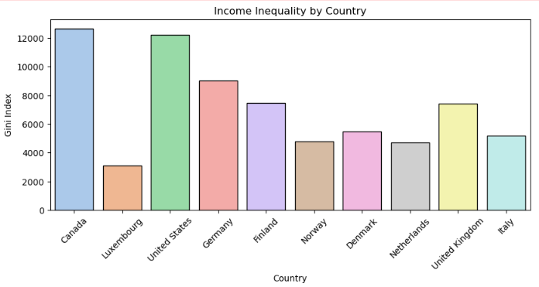
Income Inequality by Country
Key Insight :Income Inequality by Country
1.Canada and the United States sit at the top of this list, with scores exceeding 12,000.
212.,
2.Germany (~9,000) and the UK (~7,400) represent the higher end of inequality within this European group.
3.Italy, Denmark, and Norway fall into a middle-to-low tier.
4.Luxembourg stands out as the most equal in this set, with a score nearly four times lower than Canada's.
5.Norway, Denmark, and Finland are all clustered toward the lower end of the spectrum (between 4,800 and 7,500).

Slide 10
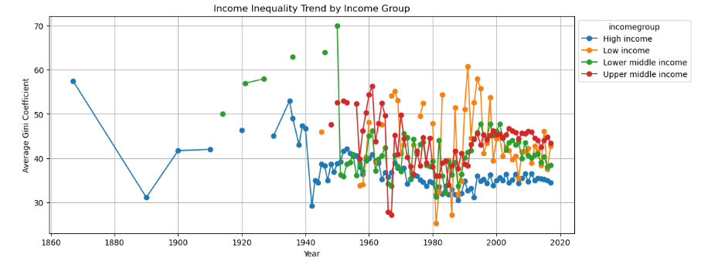
Income Inequality Trend by Income Group
Key Insight : Income Inequality Trend by Income Group
1.Since the 1980s, High-income nations (Blue line) have consistently maintained the lowest and most stable inequality levels (~35 Gini).
2.Low-income countries (Orange line) show the most in inequality during the 1990s.
3.The Lower-middle-income group reached the highest inequality in the (Gini 70) around 1950.
4.Since 2000, High-income nations are significantly more equal (35) than everyone else (45).

Slide 11
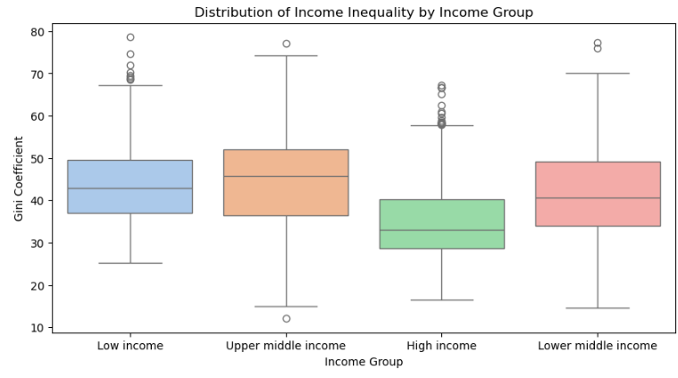
Distribution of Income Inequality by Income Group
Key Insight : Distribution of Income Inequality by Income Group
1.Upper Middle Income
The Upper Middle Income group has the highest median Gini coefficient (roughly 46).
2.High Income
The High Income group (green box) has the lowest median (roughly 33) and the most compact box.
Low Income: High (~43)
Lower Middle: Slightly lower (~41)
Upper Middle: Peaks at the highest (~46)
High Income: Drops significantly (~33)

Slide 12
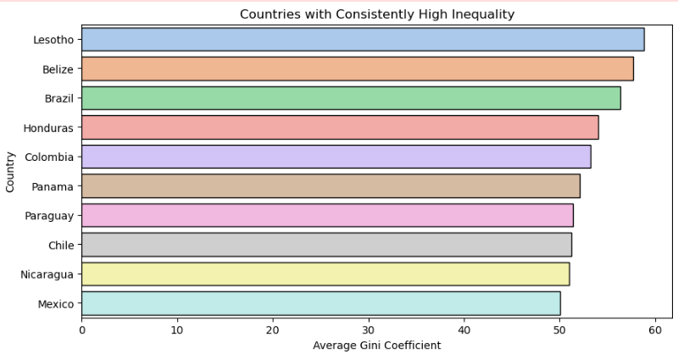
Countries with Consistently High Inequality
Key Insight : Countries with Consistently High Inequality
1.Lesotho ranks as the most unequal country in this set, with a Gini score approaching 60.
2.Very country on this list has an average Gini score above 50.

Slide 13
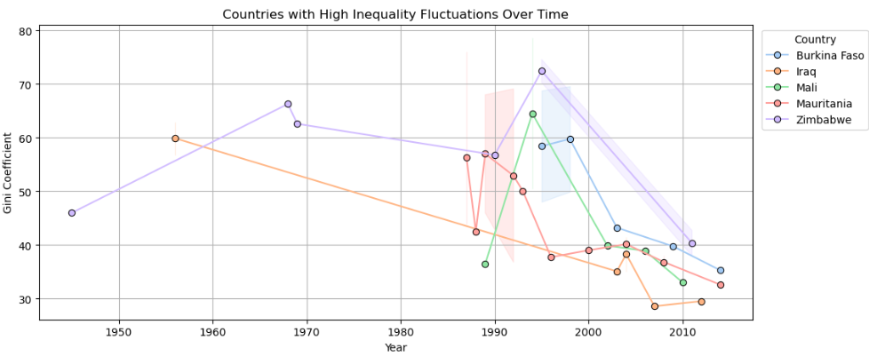
Countries with High Inequality Fluctuations Over Time
Key Insight: Countries with High Inequality Fluctuations Over Time
1.Zimbabwe (purple line) reached the highest Gini coefficient in the entire chart, peaking at over 70 in the mid-1990s.
2.Most of these countries (especially Mali, Burkina Faso, and Zimbabwe) experienced their most in inequality between 1990 and 2000.
3.Since the year 2000, nearly all countries shown (Iraq, Mali, Burkina Faso) have seen a downward trend .

Slide 14
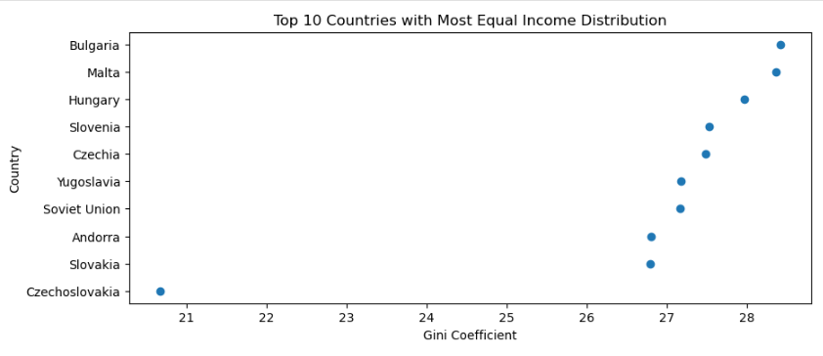
Top 10 Countries with Most Equal Income Distribution
Key Insight: Top 10 Countries with Most Equal Income Distribution
1.Czechoslovakia is the most equal entity in this list, with an exceptionally low Gini score of 20.6.
2.Most of the other top countries (like Slovakia, Soviet Union, and Yugoslavia) are tightly clustered between 26 and 28.5.

Slide 15
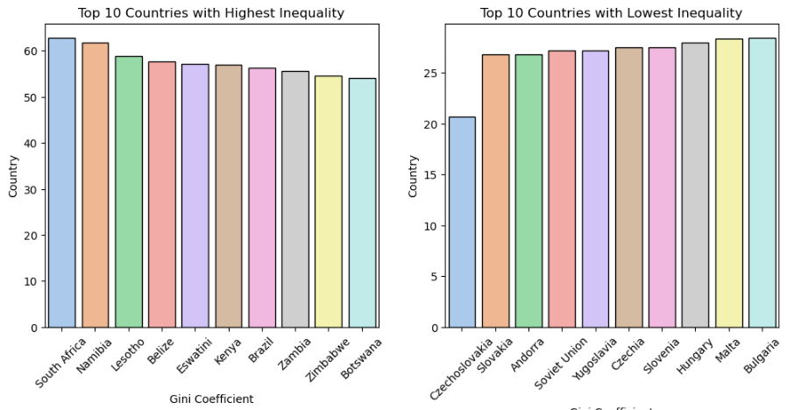
Top 10 Countries with Highest and Lowest Inequality
Key Insight: Top 10 Countries with Highest and Lowest Inequality
1.Highest Inequality: South Africa has the highest Gini score (above 60).
2.Lowest Inequality: Czechoslovakia is the most equal (~21).

Slide 16
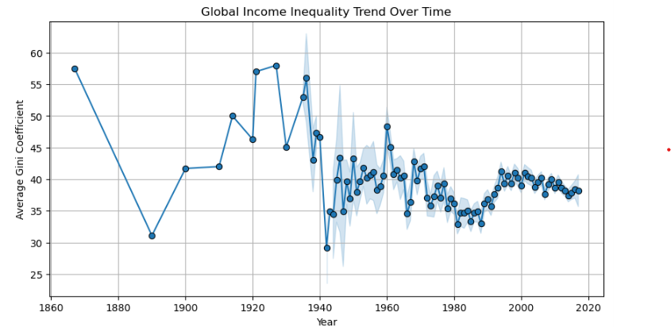
Global Income Inequality Trend Over Time
Key Insight: Global Income Inequality Trend Over Time
1.(1860–1940)
Before the 1940s, global inequality was extreme and wildly volatile, frequently peaking near a Gini of 60.
2. (1940–1950)
During the 1940s, where the global average Gini dropped to its historical low of approximately 29.
3. (1980–2000)
After reaching a localized low in the early 1980s (~33), inequality began a steady climb upward for two decades, peaking again around the year 2000 (~42).
4.(2000–Present)
Since 2000, the line has "smoothed out" significantly, hovering consistently between 38 and 40.

Slide 17
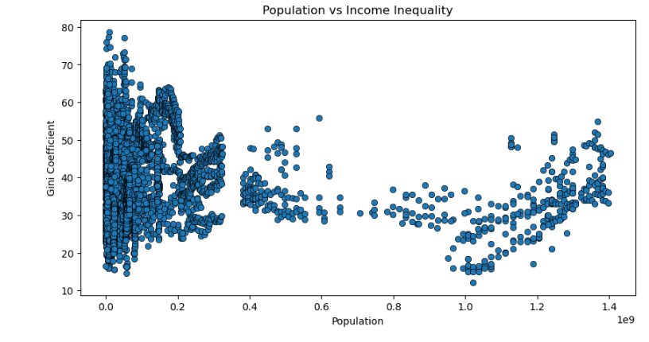
Population vs Income Inequality
Key Insight: Population vs Income Inequality
There is no strong relationship between population size and income inequality.
Highly populated countries do not necessarily exhibit higher inequality levels, as inequality is primarily influenced by economic development, government policies, and social factors rather than population size.

